Slide 1
Association between S antibody levels and immunological events (COVID-19 infection or vaccination) from nationwide community surveillance data in South Korea
Authors (TBD): Zhang, Franky; Chang, Won; Dieckhaus, Kevin; Jung, Jaehun; Jo, Youngji*; Kim, Dong-hyun*

Slide 2
Background
Previous studies identified that neutralizing antibody levels are highly predictive of immune protection from SARS-CoV-2 infection (Khoury DS et al, 2021) and the levels of antibody protection required to prevent COVID-19 (Feng S et al, 2021)
Neutralizing Antibodies: The S antibodies include neutralizing antibodies, which can directly interfere with the ability of the virus to infect cells. Higher levels of S antibodies generally correlate with a stronger capacity to neutralize the virus and prevent infection.
Vaccine Efficacy: COVID-19 vaccine efficacy is linked to strong S antibody responses. Vaccines with higher S antibody titers are generally more effective in preventing or lessening COVID-19 severity.
Duration of Protection: S antibody protection duration is being studied. Although S antibodies offer initial defense, their levels may decrease over time, reducing protection. This has prompted booster shot recommendations to sustain immunity..
Variants of Concern: The rise of SARS-CoV-2 variants has complicated how S antibody levels protect us. Variants with mutations in the S protein can lower antibody effectiveness, risking breakthrough infections in vaccinated people. Research continues to explore the protection correlation against various variants..
Measurement and Interpretation: Quantitative S antibody level assessments offer insights into immune status, but the protective threshold varies and isn't precisely defined for the population.
1
Notes:
As of December 2022, South Korea achieved a vaccination coverage of 86.43% for at least one dose ^{[1]}.
It's important to note that the immune system's protection against COVID-19 is not solely dependent on S antibodies. Other components of the immune system, including T cells, also play crucial roles in responding to infection and providing long-term immunity. Continuous research is essential for a deeper understanding of the protective mechanisms against SARS-CoV-2 and for optimizing vaccination strategies.

Slide 3
Objective
Repeated Community-Based Antibody Surveys
Lack of representative community-based seroprevalence data (most other studies are hospital-based with relatively small sample size)
Challenges in assessing risk trends based on antibody titer variations through cross-sectional surveys
1) Aim 1: Examining the association between Spike (S) protein antibody levels and COVID-19 infection (Case control study design)
2) Aim 2: Determine the change of S antibody level by infection or vaccination over time (Cohort study design)
2
Notes:
The S protein is a structural protein on the surface of the virus that facilitates its entry into human cells. Vaccines that target the S protein are designed to elicit an immune response specifically against this protein. Here’s how the S antibody level is associated with protection against COVID-19 infection:

Slide 4
Epidemic curve of COVID-19 in Korea (2020.1.20.~2023.4.20.)
Longitudinal cohort investigation with serial sampling of the same individual each time
4th peak
5th peak
6th peak
7th peak
Community-based seroprevalence survey of COVID-19 in Korea
1st peak
2nd peak
3rd peak
Follow-up survey
3

Slide 5
Method
Surveillance period: August 2022 (1st survey) – December 2022 (2nd survey) Surveillance area: 258 public health centers and 113 private medical facilities from 259 cities/counties nationwide in South Korea Surveillance subjects: 10,000 individuals aged 5+ were randomly selected from 5,000 households. Surveillance method: Nationwide community-based surveillance. Surveyors conduct one-on-one interviews via tablets.
4
Notes:
First say what is antibody, two type of antibodies. N+ means infection before. S+ means infection/vaccinated.

Slide 6
Population immunological status by S/N ab level
N+
Hybrid immunity
(Vaccinated & Infection OR Infection only)
S+
10,000
Subjects
N-
Vaccinated
N+
Infection only
(or Infection and poor Vaccination response)
S-
N-
Naïve
(No Infection & No Vaccination)
5

Slide 7
Study design
Aim 1: Nested case-control study design
Aim 2: Cohort study design
Outcome measurement: Confirmed infection between 1st and 2nd surveillance
Exposure measurement: anti-Spike (S) antibody level
Statistical analysis: Logistic regression, Statistical inference
Outcome measurement: Immunological events (Infection and/or vaccination) between 1st and 2nd surveillance
Exposure measurement: Hybrid immunity and vaccine-induced immunity
Statistical analysis: Descriptive analysis
6

Slide 8
Case control study design
9,945
Total amount of objects in
the 1st surveillance
Exclude those who did not attend or missing S antibody level in the 2nd survey (n = 2,423)
Exclude the population with vaccination between 1st survey and infection if had (n =22)
Exclude the population with increased S Antibody level in the 2nd survey (n = 1,207)
Confirmed infection
between 1st and 2nd Survey (n = 744)
No infection
between 1st and 2nd Survey (n = 5,549)
Exclude those had N- antibody at the 2nd Survey (n = 76)
Exclude the population with vaccination during 1st and 2nd Survey (n = 1,349)
Included in the Case Group :
n = 668
Included in the Control Group:
n = 4,200
7

Slide 9
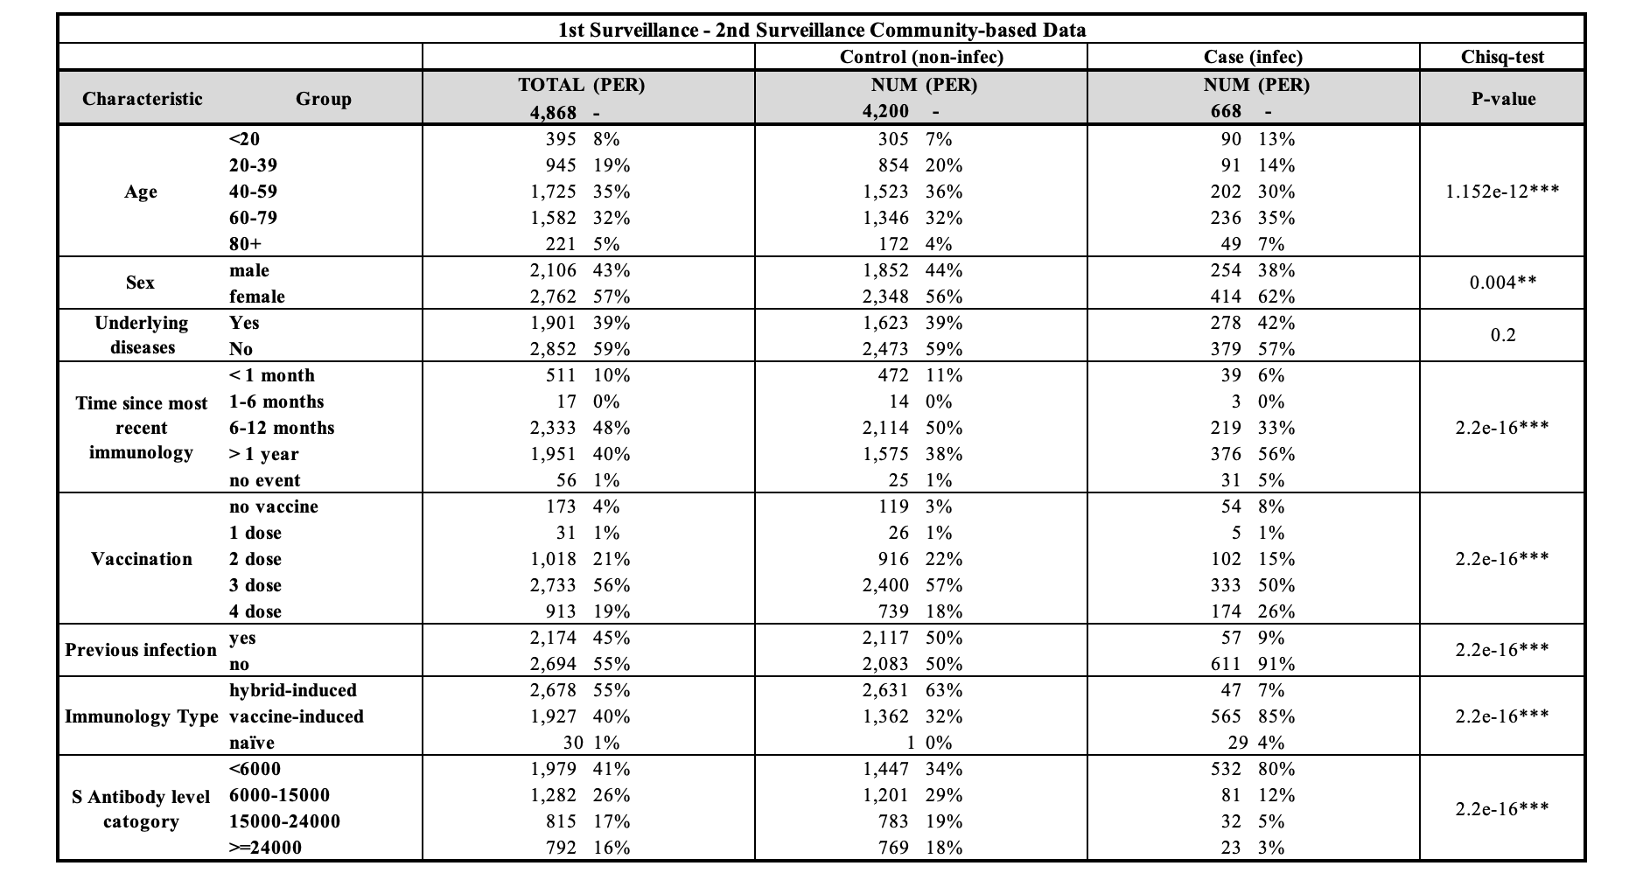
Summary table comparing case and control group characteristics
8

Slide 10
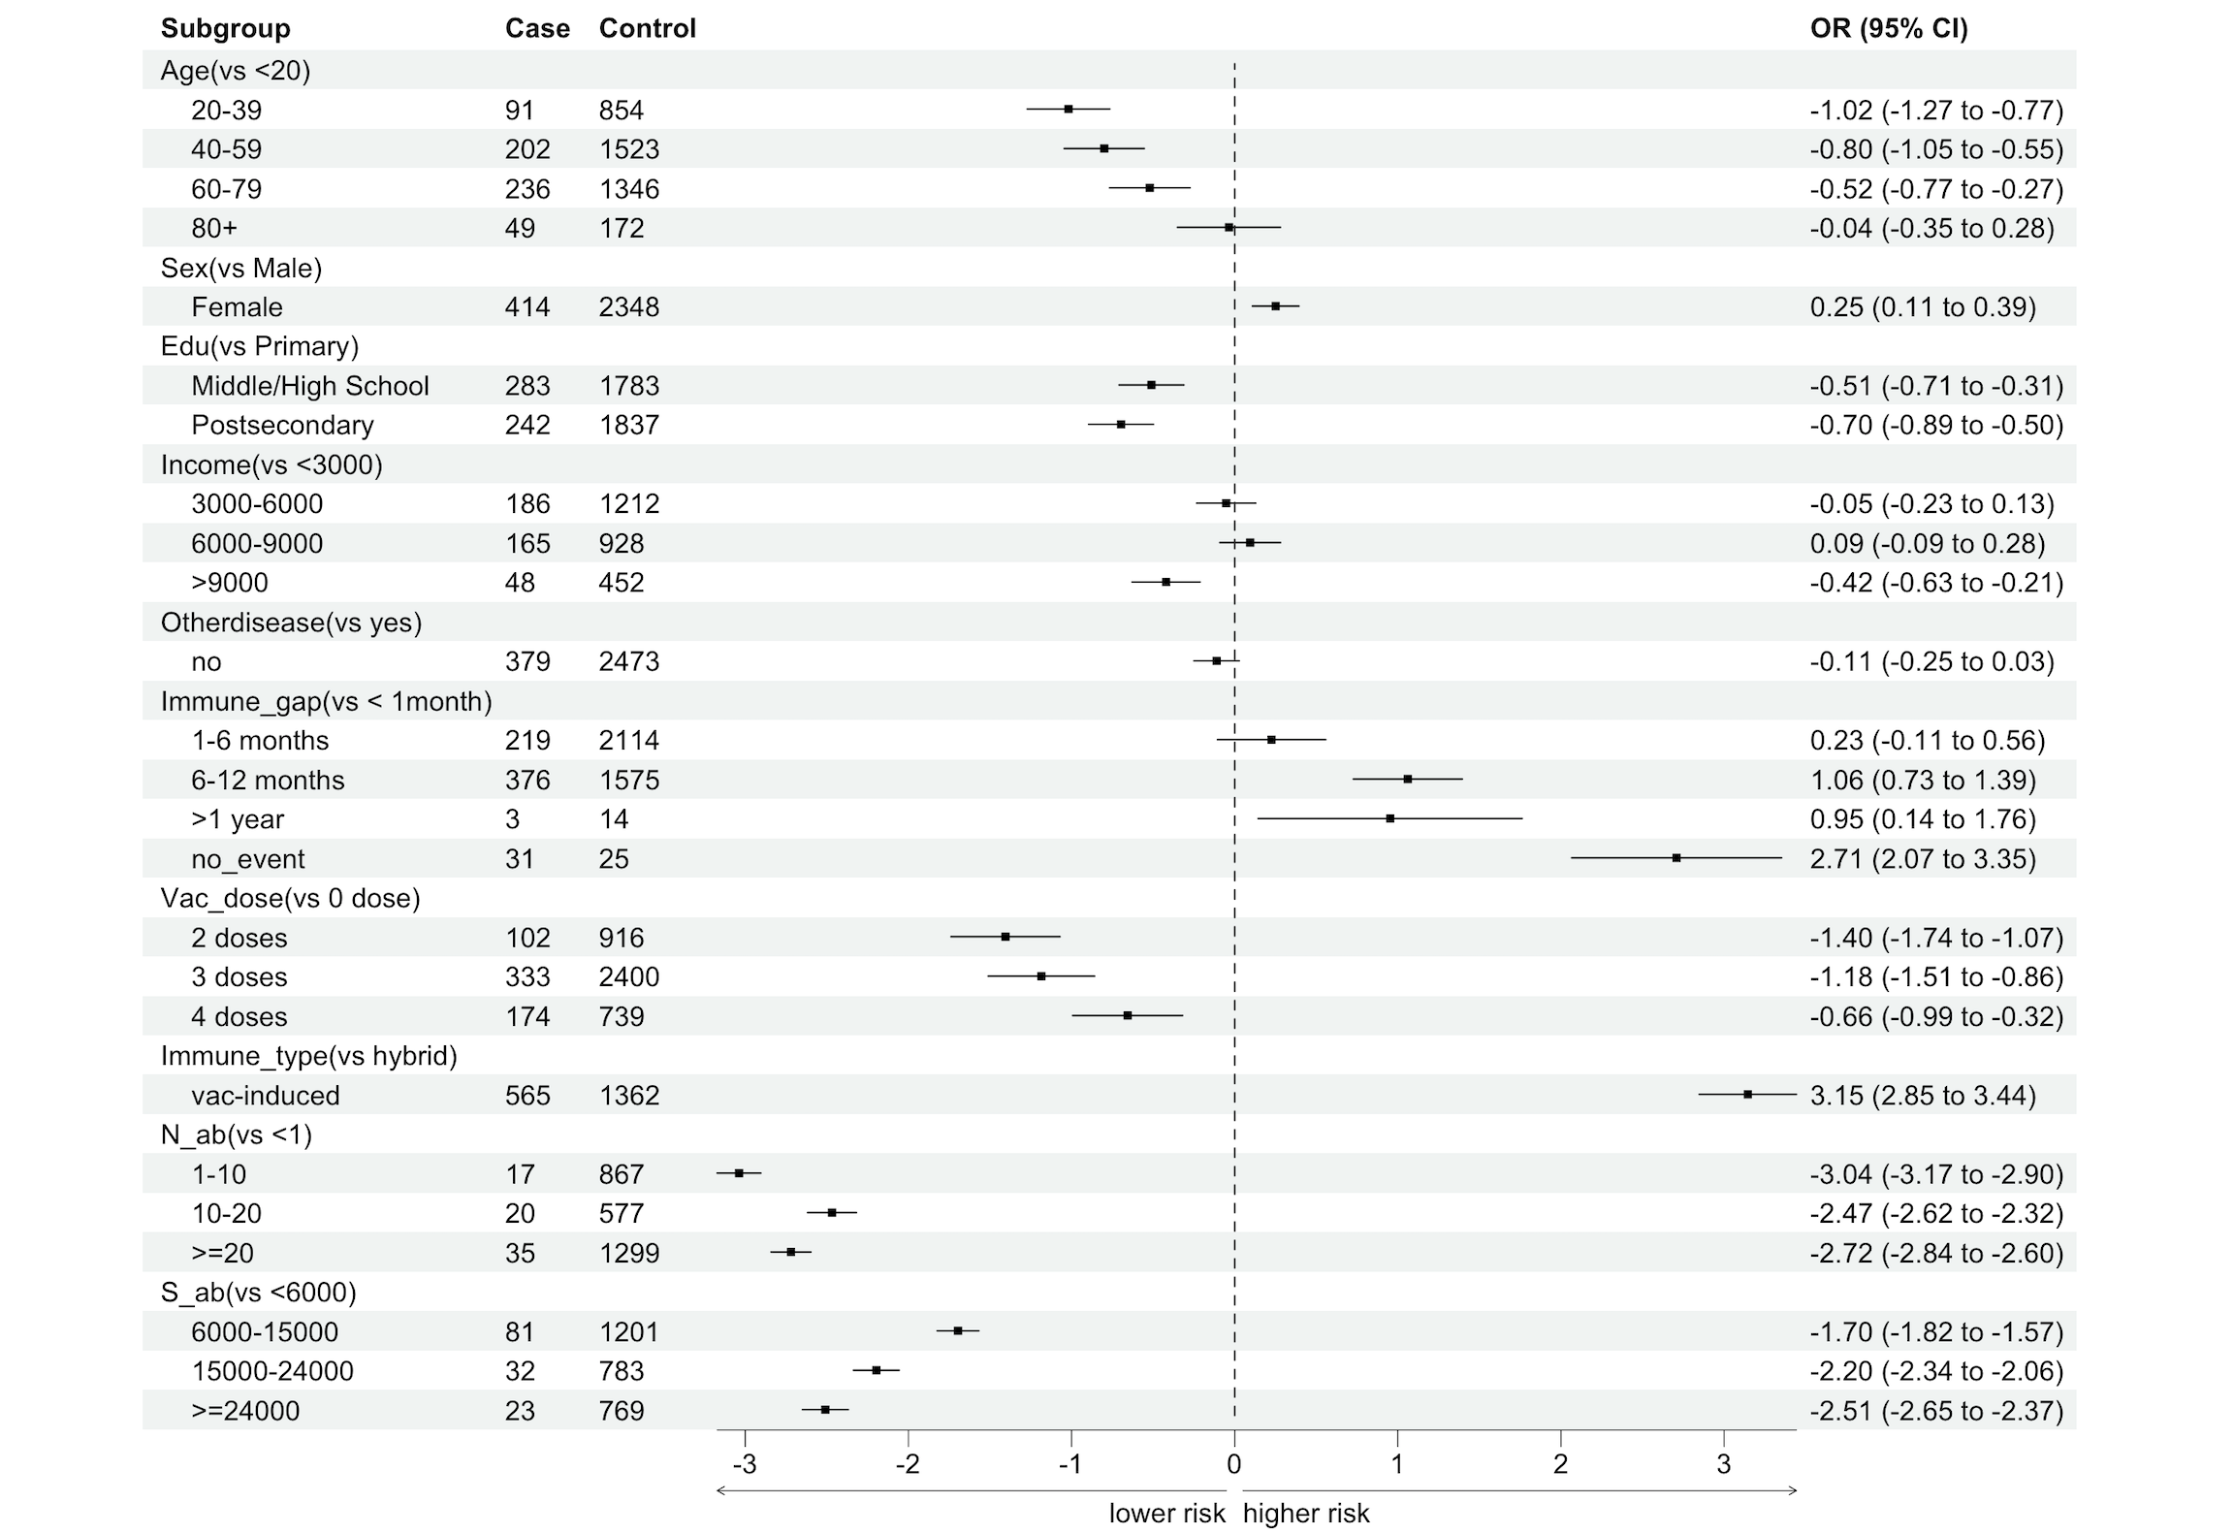
Forest plot showing infection risk odds ratios
9

Slide 11
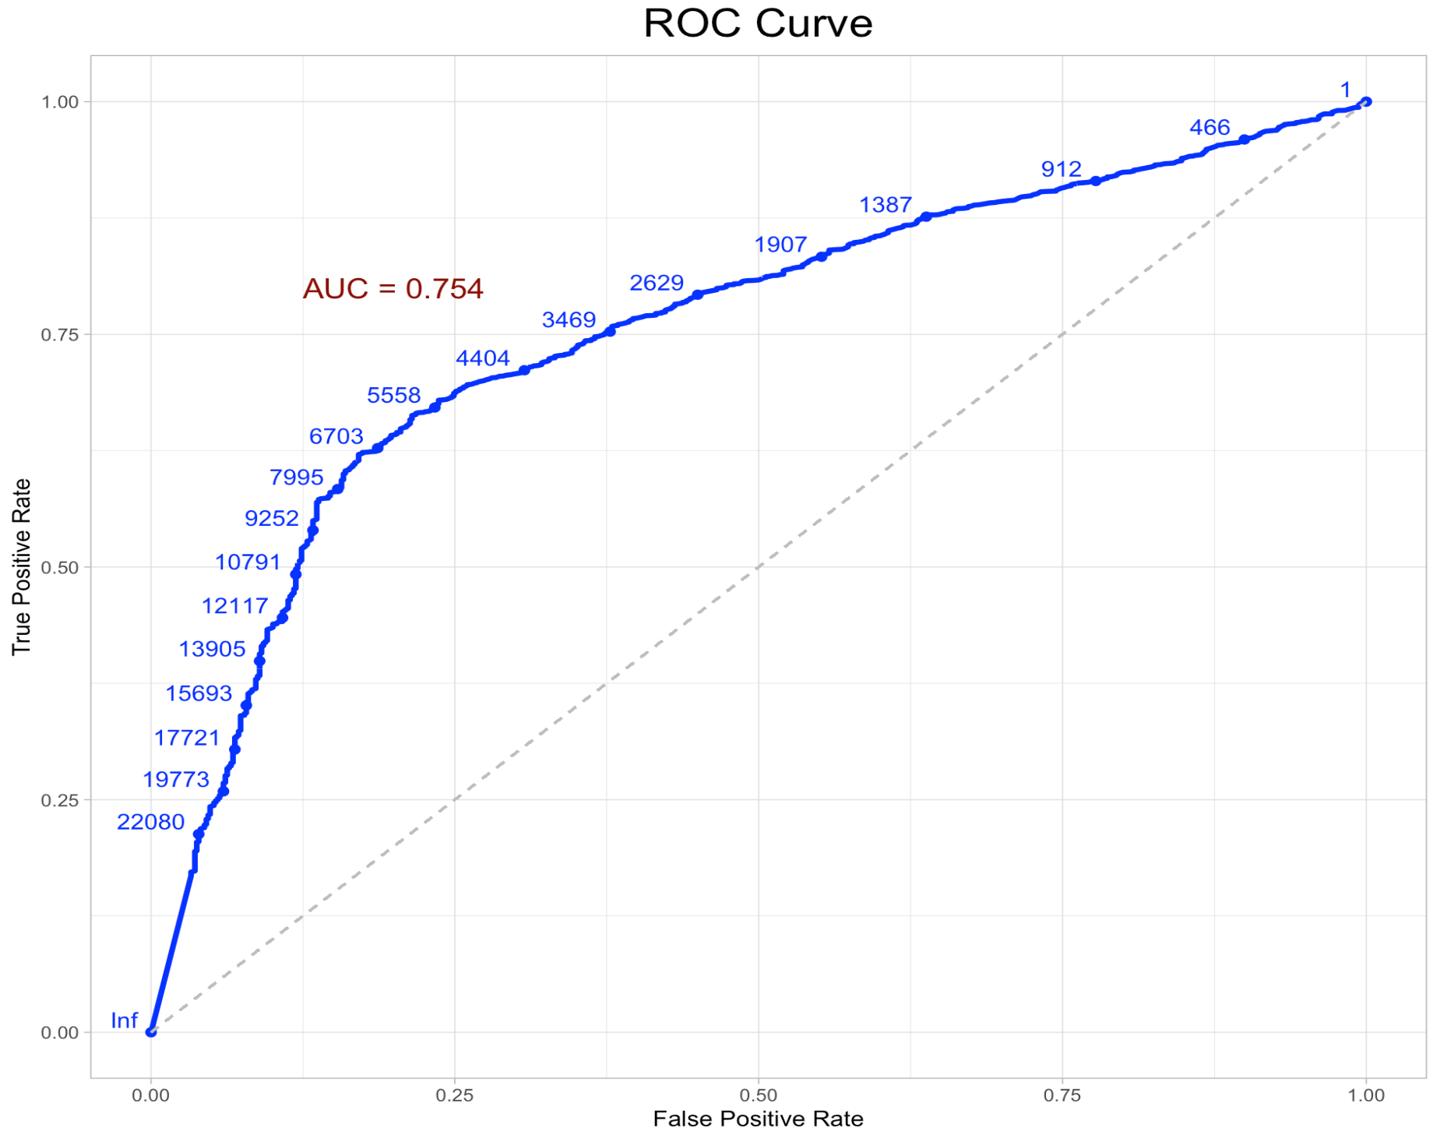
ROC Curve
(model: Infection ~ S antibody level)
10

Slide 12
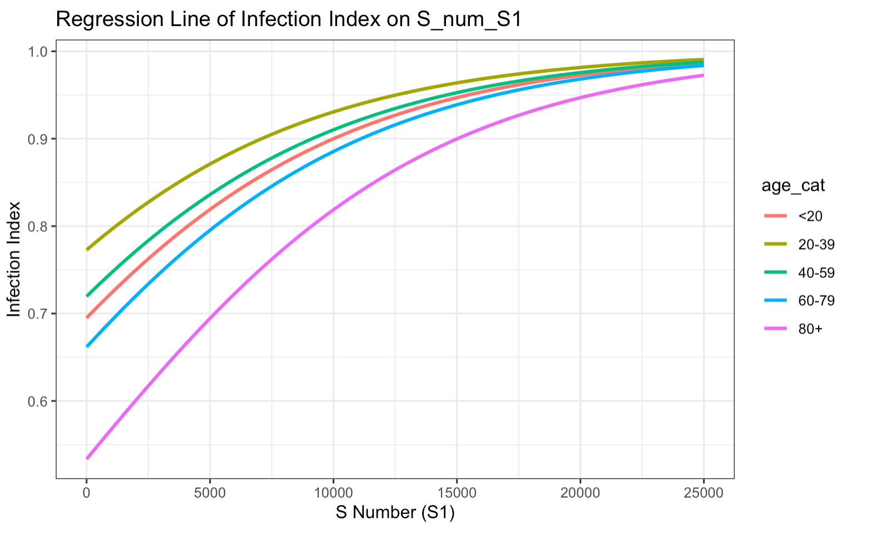
Logistic regression curve (model: Infection ~ S antibody level + Age)
No infection
.89
.85
.84
.82
.71
Infection
11

Slide 13
Cohort study design
Object of investigation
(1st Surveillance)
N = 9,945
Hybrid-induced (S+N+)
(Vaccinated & Infection)
N = 3,709(37%)
Vaccine-induced (S+N-)
(Vaccinated only)
N = 3,019(30%)
Infection-induced (S-N+)
(Infection only)
N = 19 (0.2%)
Naïve (S-N-)
(No Vaccination/Infection)
N = 119(2%)
Infec only
N = 46 (1%)
Vac only
N = 634 (17%)
Infec & Vac
N = 2 (0%)
non-Infec
N = 3,027 (82%)
Infec only
N = 532 (18%)
Infec only
N = 697 (23%)
Infec & vac
N = 53 (2%)
non-Infec
N = 1,737 (58%)
Breakthrough infection/reinfection
Breakthrough infection
12

Slide 14
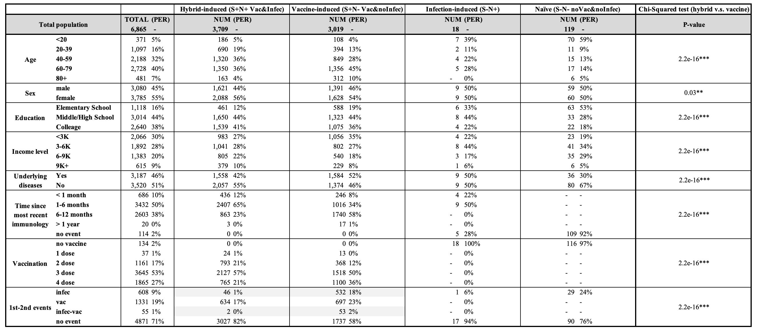
Summary table of immunology population
13

Slide 15
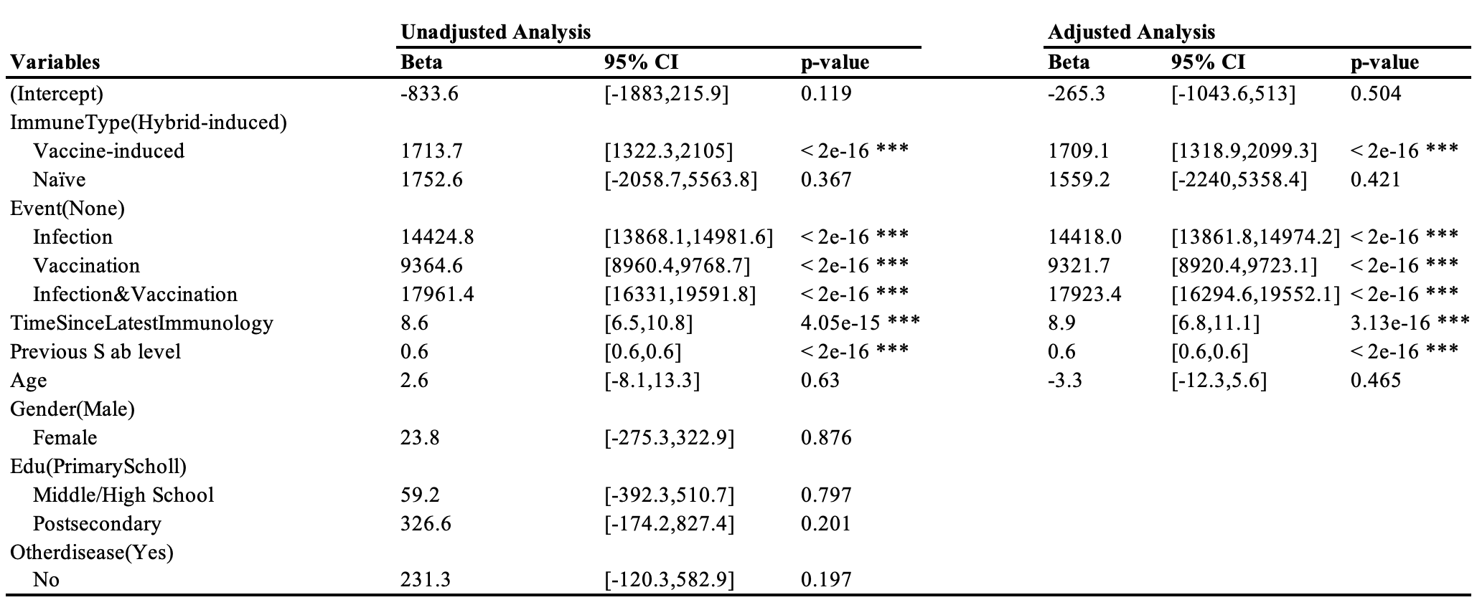


Linear regression of the change of S Antibody level
$${Adjusted: 2}^{nd}Sab level=β_{0}^{∗}+β_{1}^{∗}∗ImmuneType+β_{2}^{∗}∗Event+β_{3}^{∗}∗TimeSinceLatestImmune+β_{4}^{∗}∗1^{st}Sab level+β_{5}^{∗}∗Age+ε^{∗}$$
*$The F stastistic for the hypothesis is 1.21 with df=4, the p value is .30 and the reduced model is accepted$
14

Slide 16
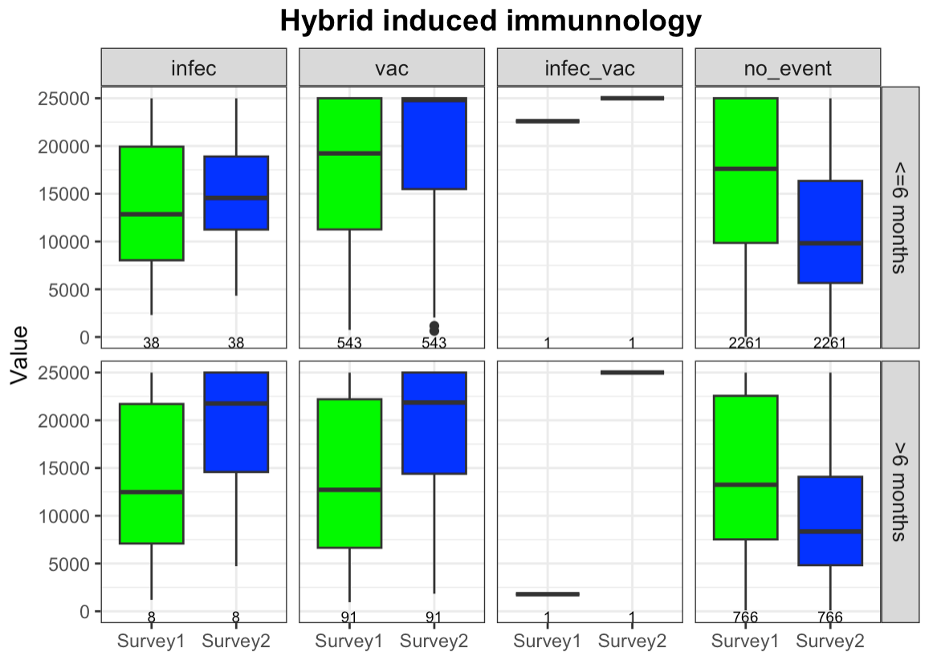
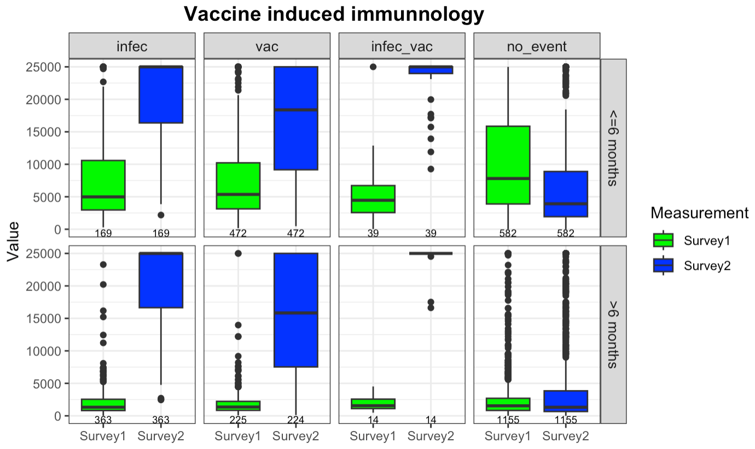
Box plot comparing S antibody level by latest immunology events
The vaccine-induced population had a bigger boost in their S antibody levels than hybrid-induced ones, no matter if they were vaccinated, infected, or both.
15

Slide 17
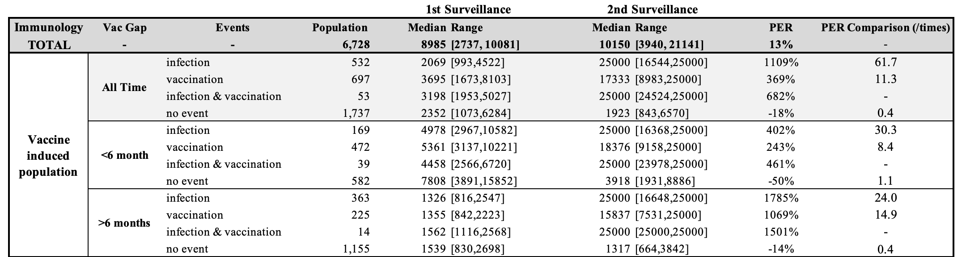
Summary table quantifying S antibody level changes between 1st and 2nd surveillance
According to the summary table, the increase rate for the vaccine-induced group, regardless of the type of immunological events, is at least eight times higher than that observed in the hybrid-induced group.
16

Slide 18
Box plot comparing S antibody level by latest immunology events
The longer the gap since the last immunological event, the lower the initial level of S antibodies. Additionally, the greater the boost—regardless of whether it’s due to infection, vaccination, or both—indicating that after such events, the depleted S antibody levels recover rapidly.
17

Slide 19
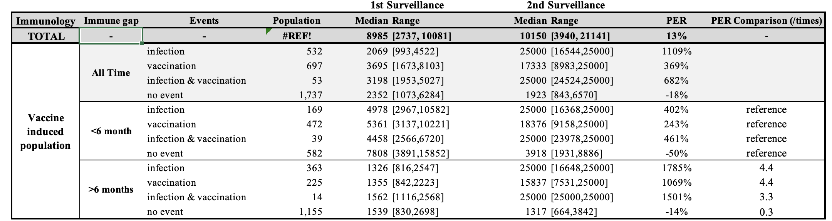
Summary table quantifying S antibody level changes between 1st and 2nd surveillance
According to the summary table, the increase rate for over 6 months , regardless of the type of immunological events, is at least eight times higher than that observed in the hybrid-induced group.
18

Slide 20
Discussion
Case control study design:
Population Spike (S) antibody level threshold can guide appropriate vaccination interval by age group.
Age presents a clear correlation with COVID-19 infection risk, indicating that the age 80+ groups face the highest risk than younger groups (89% versus 71%)
Cohort study design:
Overall, the hybrid-induced population had a lower likelihood of infection, associated with higher Spike (S) antibody levels.
The Spike (S) antibody level four months post-exposure is primarily influenced by immune type, subsequent immunological events, the time elapsed since the most recent immunological event, and the current Spike antibody level. Among these factors, the current Spike antibody level and subsequent immunological events are the most dominant, accounting for the majority of the variance in the model.
Compared to the hybrid-induced population, the naive and vaccine-only induced populations respond more effectively to an additional vaccine, achieving a significantly faster increase in Spike antibody levels.
19
Notes:
Symptom intensity varies widely, but our study data is confined to binary (Yes/No) responses.
Spike (S) antibody levels do not account for neutralizing antibodies, which may better predict symptom severity.

Slide 21
Discussion
Limitations:
The surveillance data was not collected through a scientifically randomized design; therefore, the validity of comparisons and analyses may be completely compromised.
From a logical standpoint, it’s possible that individuals exhibiting both S and N antibodies have been exposed solely through infection. However, given their minimal representation in the sample, the cohort study has categorized them as hybrid-induced for the purposes of analysis.
Other aspects of immune function, including NK cells [39] and spike specific T-cell immunity [40], were not evaluated, but they likely also play an important role in immunity to SARS-CoV-2.
The evaluation was confined to data points obtained prior to widespread booster doses of vaccination for HCWs, which typically became available between Month 9 and Month 12 of follow-up for this HCW cohort.
20

Slide 22
Reference
[1] https://ourworldindata.org/covid-vaccinations
[2] Amjadi, M. F., & O'Connell, S. E. (2021). Specific COVID-19 symptoms correlate with high antibody levels against SARS-CoV-2. *AAI*.
[3] Imai, K., Kitagawa, Y., Tabata, S., Kubota, K., Nagura-Ikeda, M., Matsuoka, M., Miyoshi, K., Sakai, J., & all authors. (2021). Antibody response patterns in COVID-19 patients with different levels of disease severity in Japan. *Journal of Medical Virology*.
[4] Goldblatt, D., Fiore-Gartland, A., Johnson, M., Hunt, A., Bengt, C., Zavadska, D., Snipe, H. D., Brown, J. S., Workman, L., Zar, H. J., Montefiori, D., Shen, X., Dull, P., Plotkin, S., Siber, G., & Ambrosino, D. (2021). Towards a population-based threshold of protection for COVID-19 vaccines. *Vaccine*.
18

Slide 23
Appendix

Slide 24
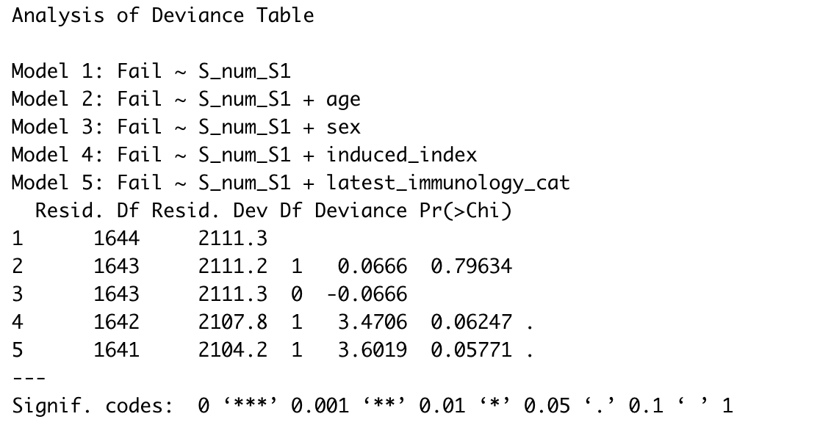





Model Comparison
$$Baseline model:infec=β_{0}+β_{1}∗Sab_{level}+ε$$
$$model1:infec=β_{0}+β_{1}∗Sab_{level}+β_{2}∗age+ ε$$
$$model2:infec=β_{0}+β_{1}∗Sab_{level}+β_{2}∗sex+ ε$$
$$model3:infec=β_{0}+β_{1}∗Sab_{level}+β_{2}∗immune type+ ε$$
$$model4:infec=β_{0}+β_{1}∗Sab_{level}+β_{2}∗latest immune gap+ ε$$

Slide 25
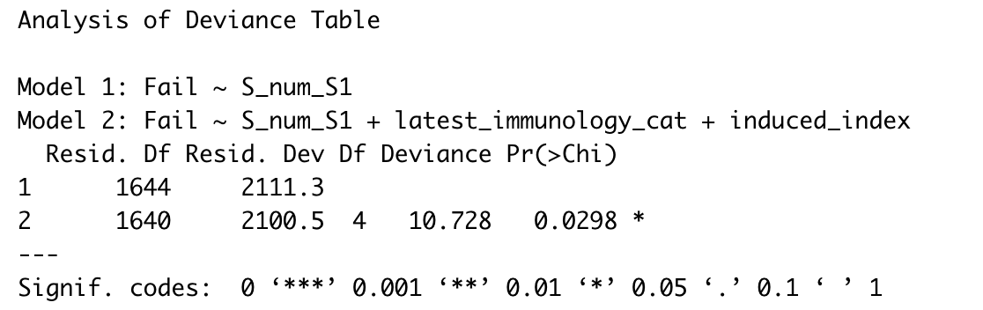
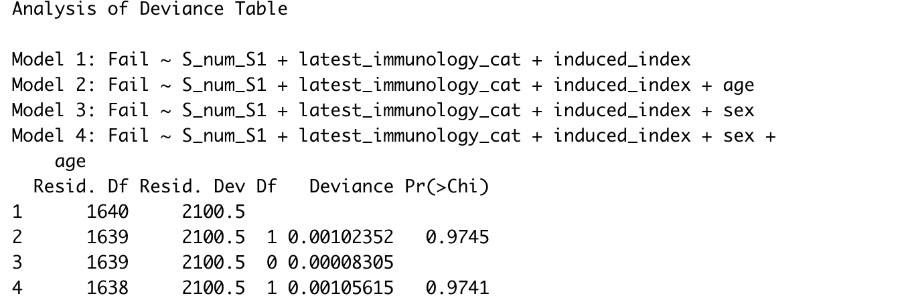





Model Comparison
$$Baseline model:infec=β_{0}+β_{1}∗Sab_{level}+ε$$
$$model5:infec=β_{0}+β_{1}∗Sab_{level}+β_{2}∗immune type+β_{3}∗latest immune gap+ ε$$
$$model6:infec=β_{0}+β_{1}∗Sab_{level}+β_{2}∗immune type+β_{3}∗latest immune gap+β_{4}∗age + ε$$
$$model7:infec=β_{0}+β_{1}∗Sab_{level}+β_{2}∗immune type+β_{3}∗latest immune gap+β_{4}∗sex + ε$$
$$full model:infec=β_{0}+β_{1}∗Sab_{level}+β_{2}∗immune type+β_{3}∗latest immune gap+β_{4}∗age +β_{5}∗sex+ ε$$

Slide 26

Final Model
$$final model :infec=β_{0}+β_{1}∗Sab_{level}+β_{2}∗immune type+β_{3}∗latest immune gap+ ε$$

Slide 27
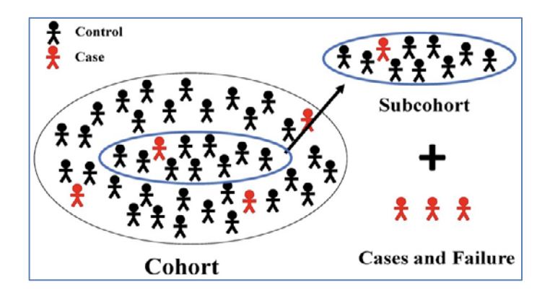
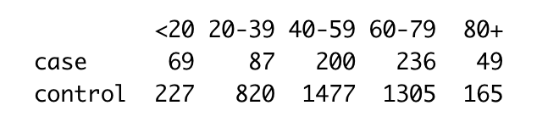
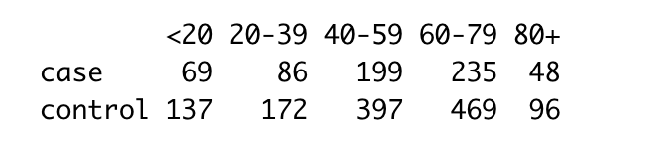
Methodology
Nested Case-control Study (NCC)
Unbalanced case-control data refer to a situation in epidemiological and medical research where the number of cases does not match the number of controls.
To maximize statistical efficiency and minimize bias, for each case, a subset of controls is selected from the same cohort. Controls are often matched to cases on various factors like age, gender, or other characteristics to ensure comparability.
{Epi} in R, by B. Carstensen and M. Plummer, Mar 30, 2024
Raw Case-control cohort
Nested Case-control design cohort

Slide 28
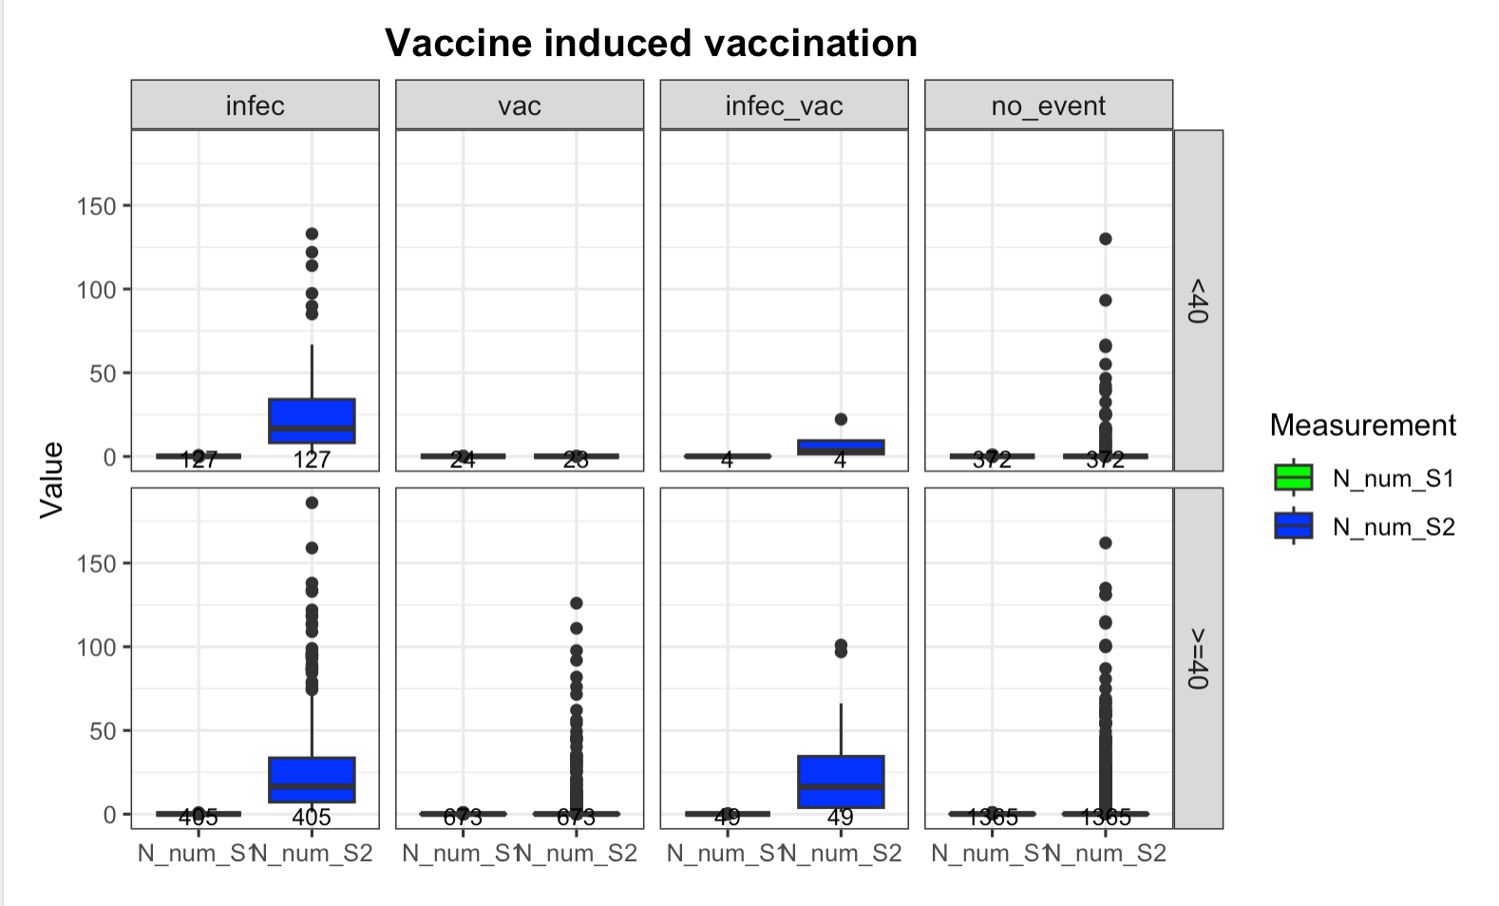
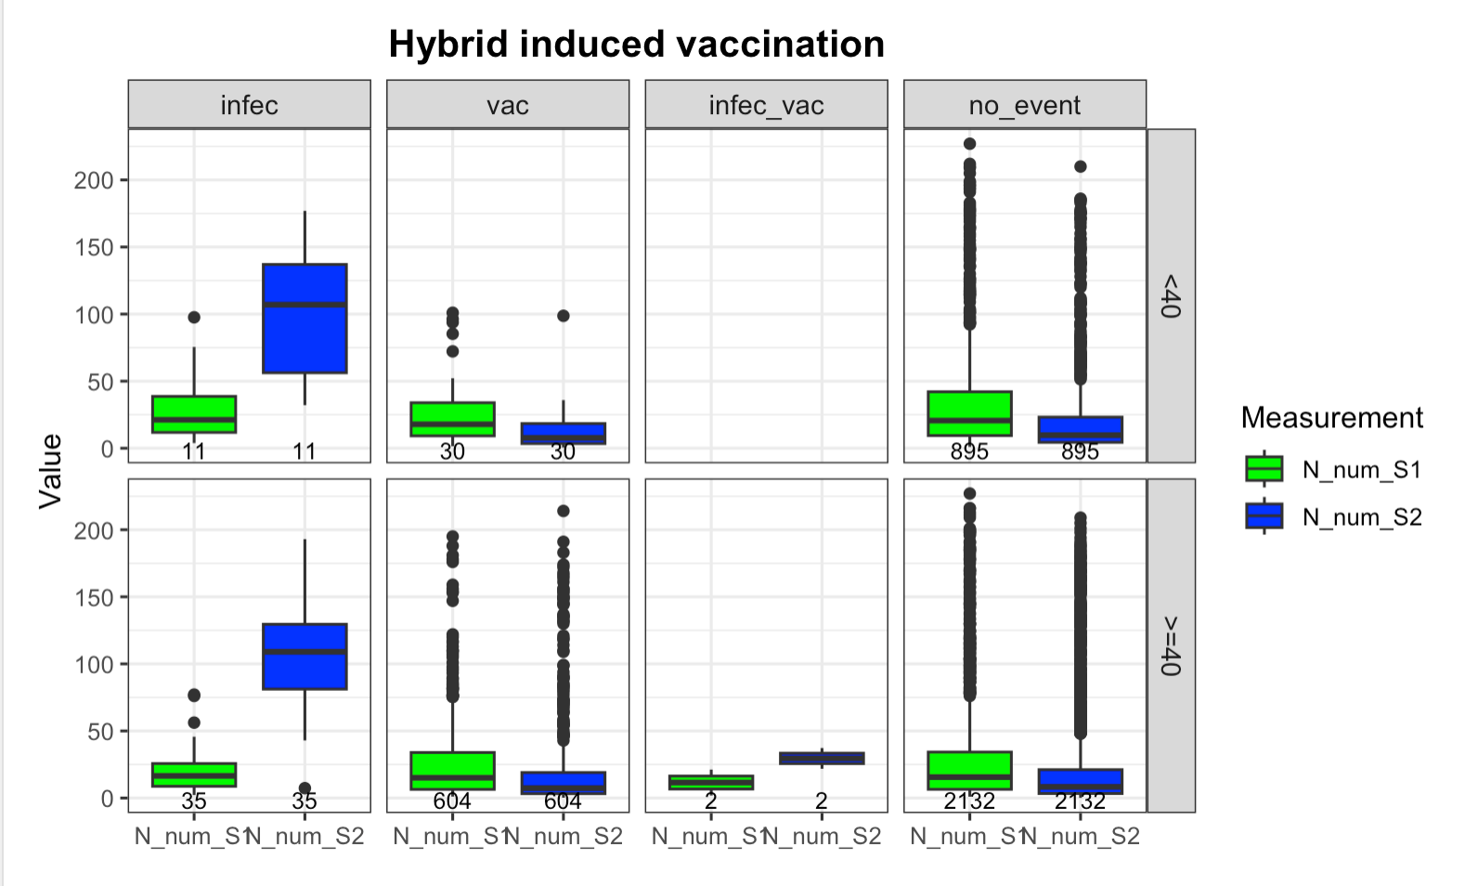
Figure 2: Box plots for N antibody level grouped by Age and later events
The trends in N antibody levels are not well-defined, as these antibodies are typically produced only in response to an infection.

Slide 29
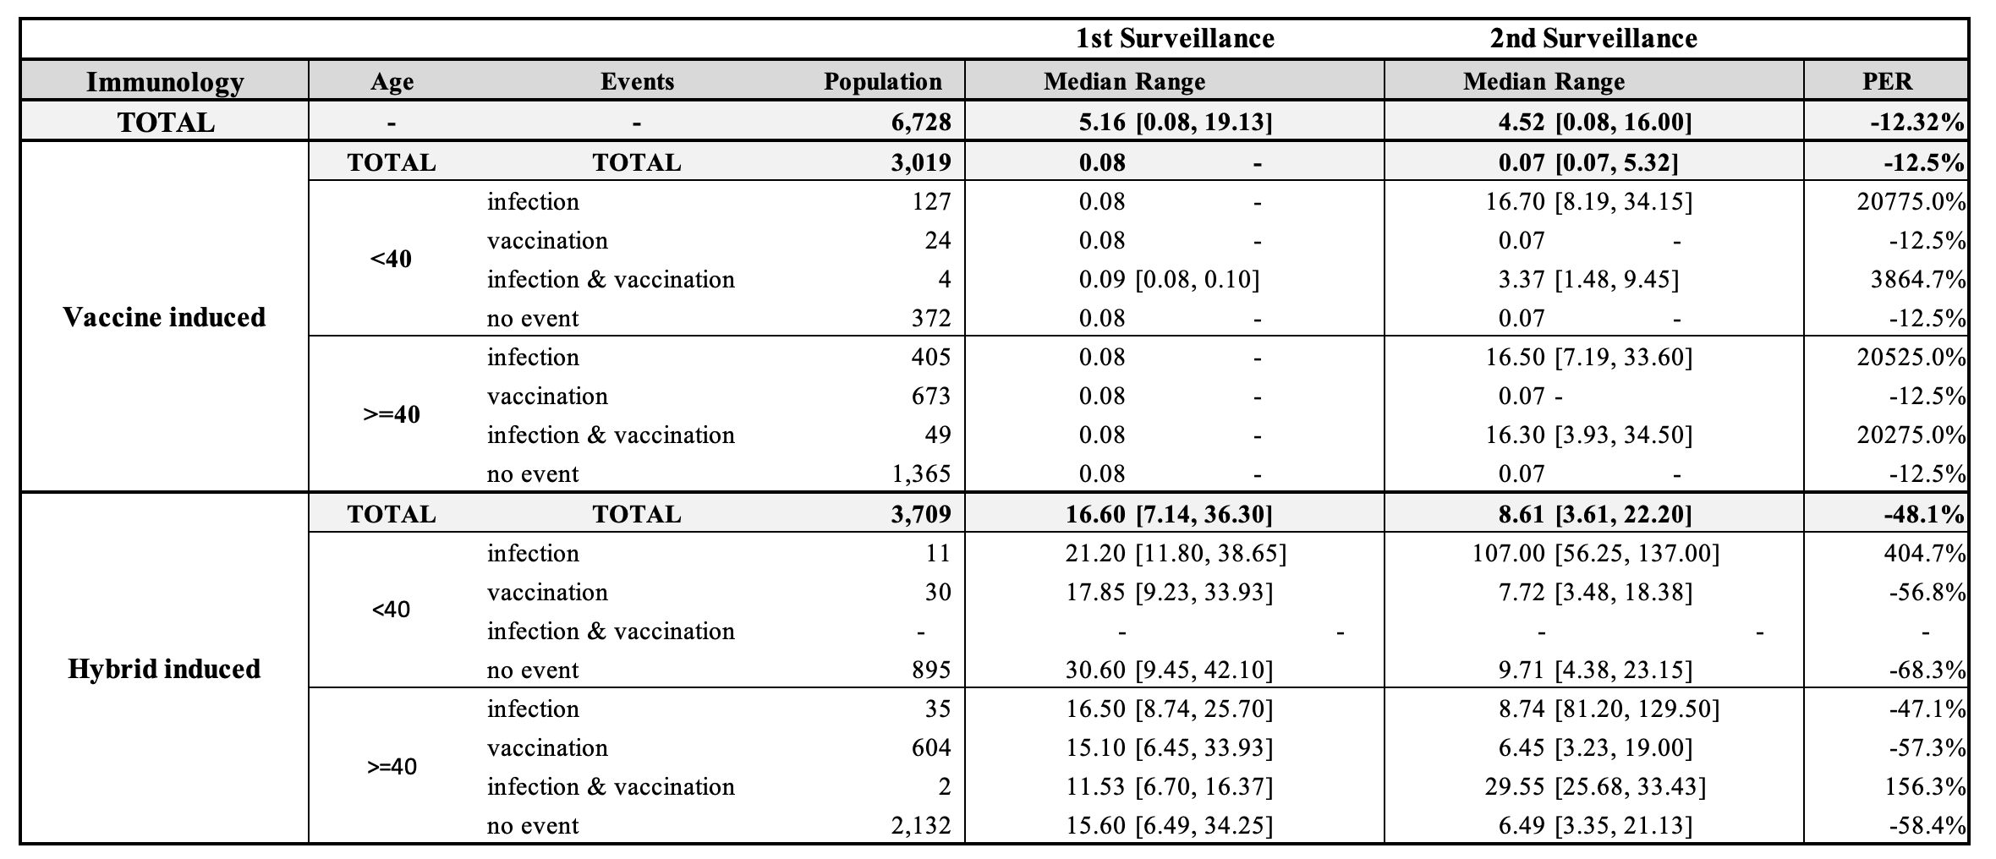
Table 3: Quantification table for the difference of N antibody level from 1st to 2nd Surveillance

Slide 30
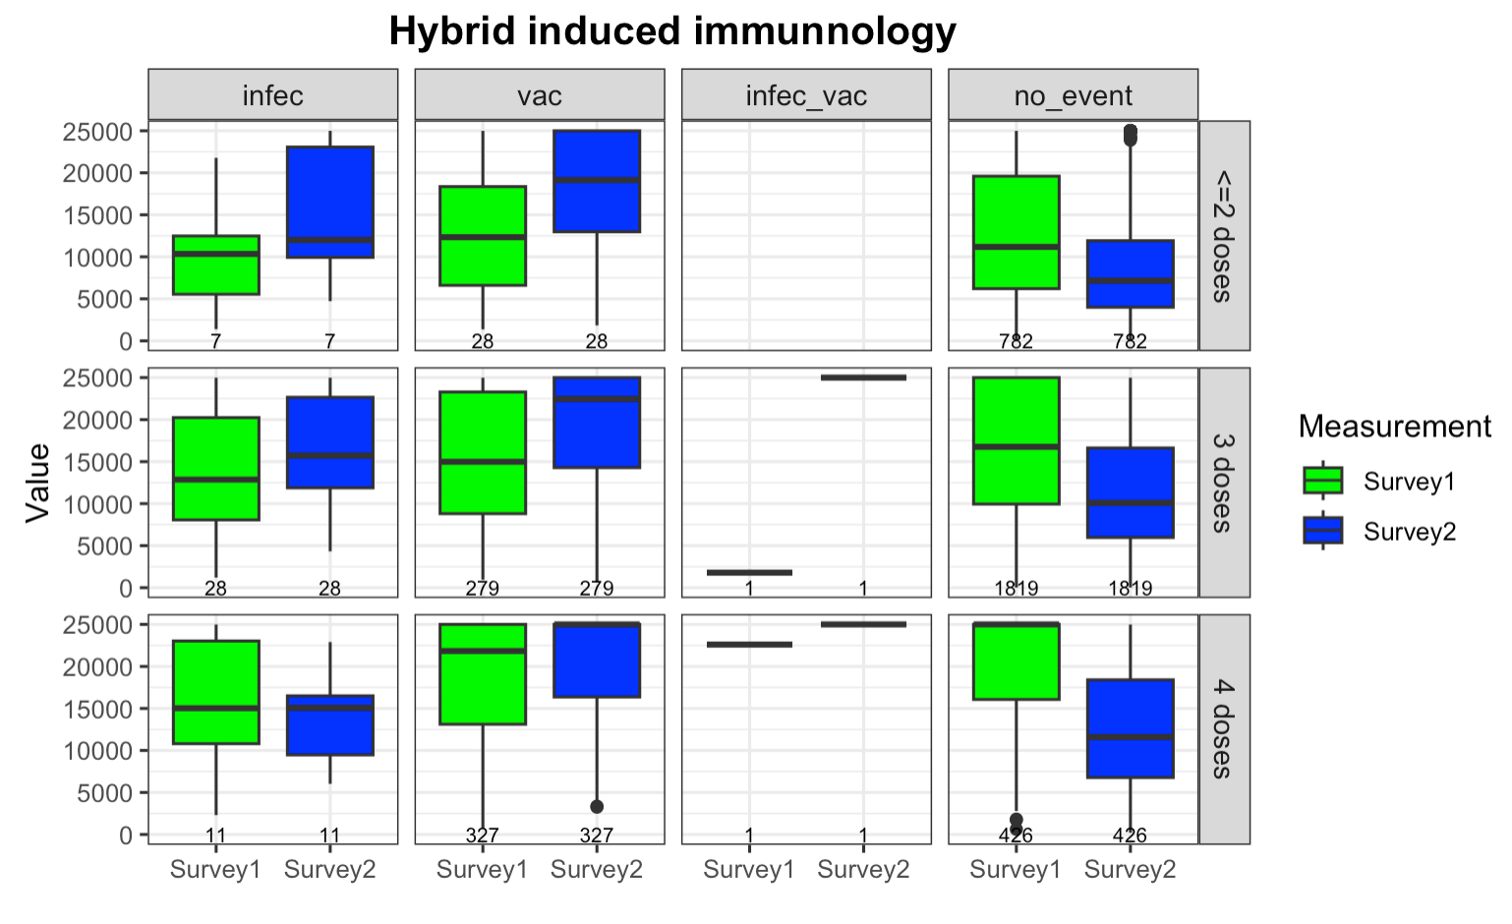
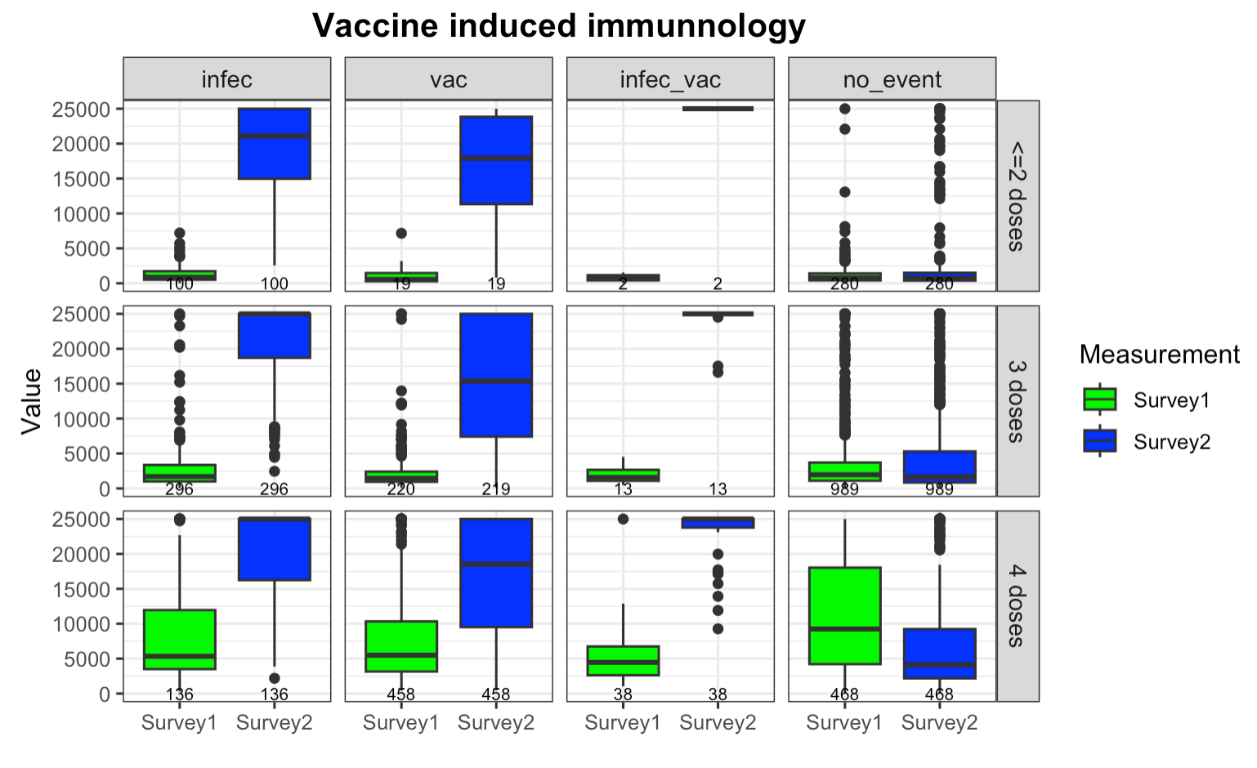
Box plot comparing S antibody level changes between 1st and 2nd surveillance

Slide 31
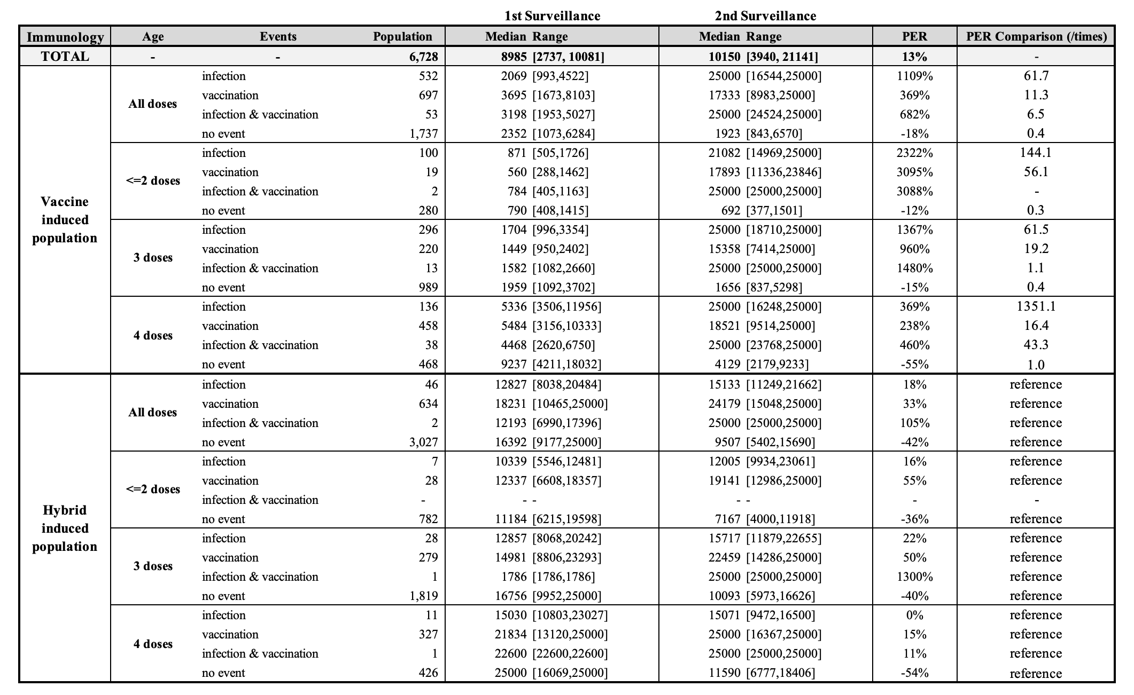
Summary table quantifying S antibody level changes between 1st and 2nd surveillance

Slide 32
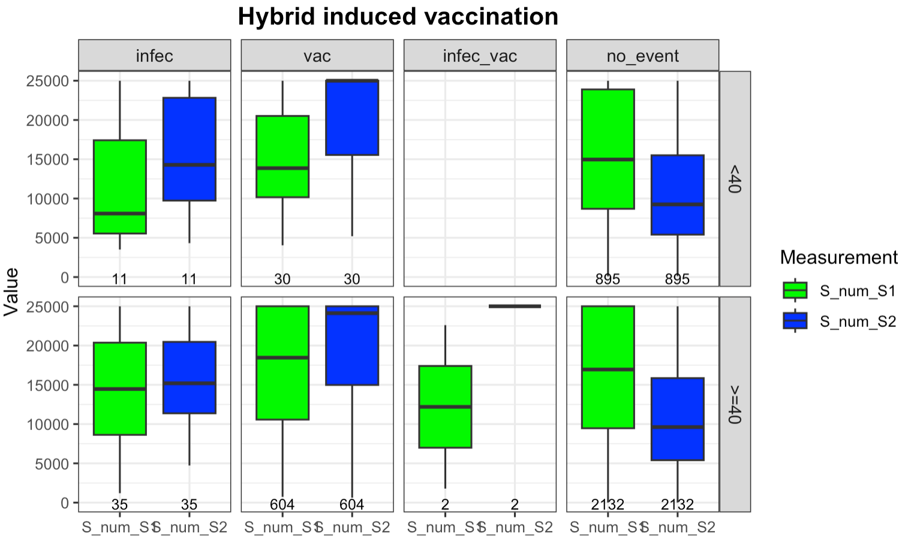
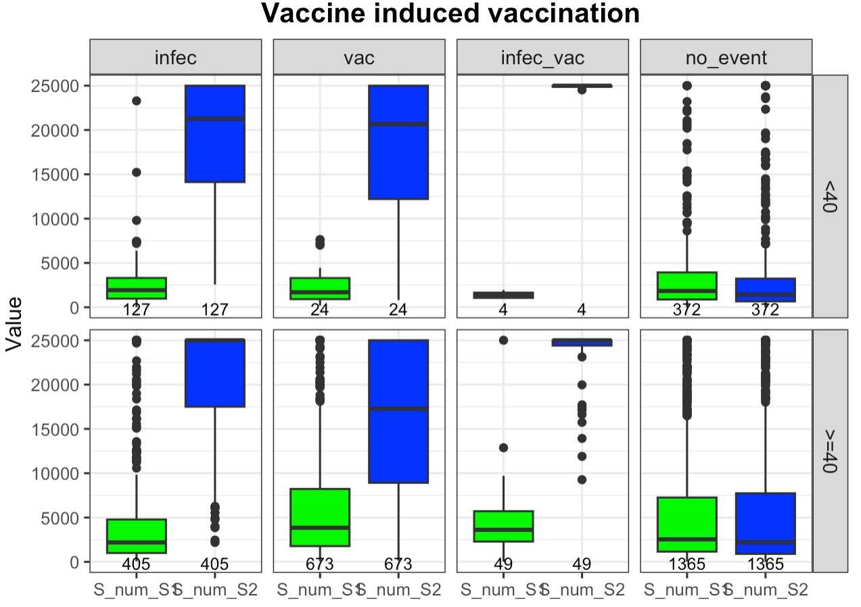
Box plot comparing S antibody level changes between 1st and 2nd surveillance
The vaccine-induced population had a bigger boost in their S antibody levels than hybrid-induced ones, no matter if they were vaccinated, infected, or both.
12

Slide 33
Box plot comparing S antibody level changes between 1st and 2nd surveillance
If no events occur, the rate of decrease in S antibody levels in the vaccine-induced population is lower compared to the hybrid-induced group.
12

Slide 34
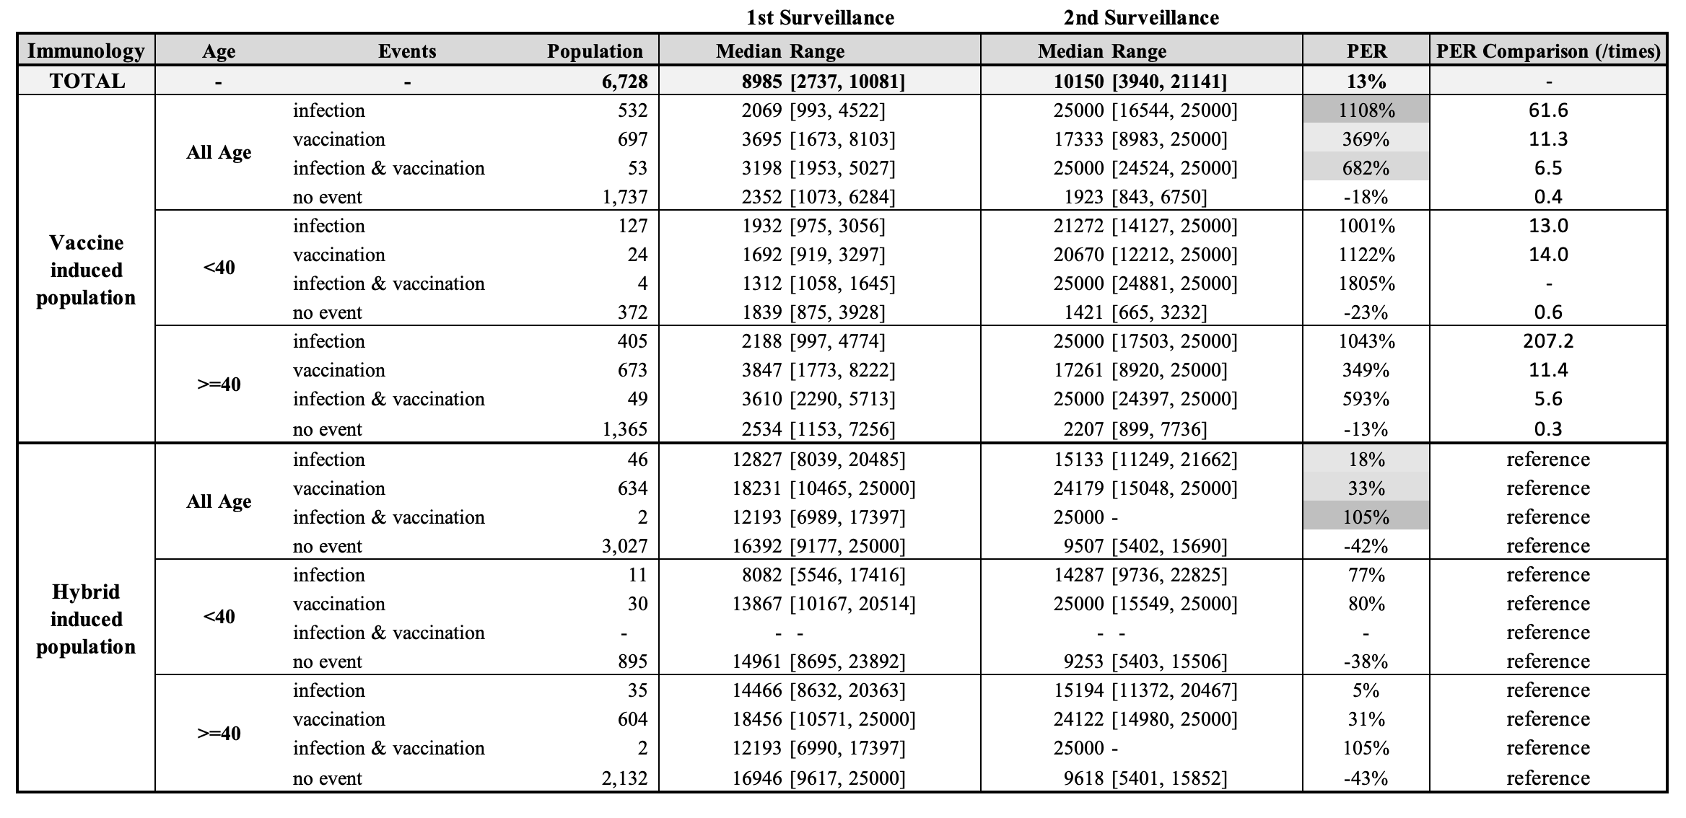
Summary table quantifying S antibody level changes between 1st and 2nd surveillance
The increase in S antibody levels among the vaccine-induced population is at least 6 times greater than that of the hybrid-induced population, regardless of whether they have undergone infection, vaccination, or both.
13

Slide 35
Summary table quantifying S antibody level changes between 1st and 2nd surveillance
If no events occurred, the rate of decline in S antibody levels for the vaccine-induced population is only half that observed in the hybrid-induced population.
14

Slide 36
Summary table quantifying S antibody level changes between 1st and 2nd surveillance
Regardless of immunity type, younger individuals showed a greater increase in S antibody levels after infection or vaccination, and a faster decline in the absence of these events, especially in the vaccine-induced group. The later pattern was not observed in the hybrid-induced group.
15

Slide 37
Summary table quantifying S antibody level changes between 1st and 2nd surveillance
Across various events, infection leads to a higher S antibody level increase in the vaccine-induced population, whereas vaccination prompts a greater rise in the hybrid-induced group.
16

Slide 38
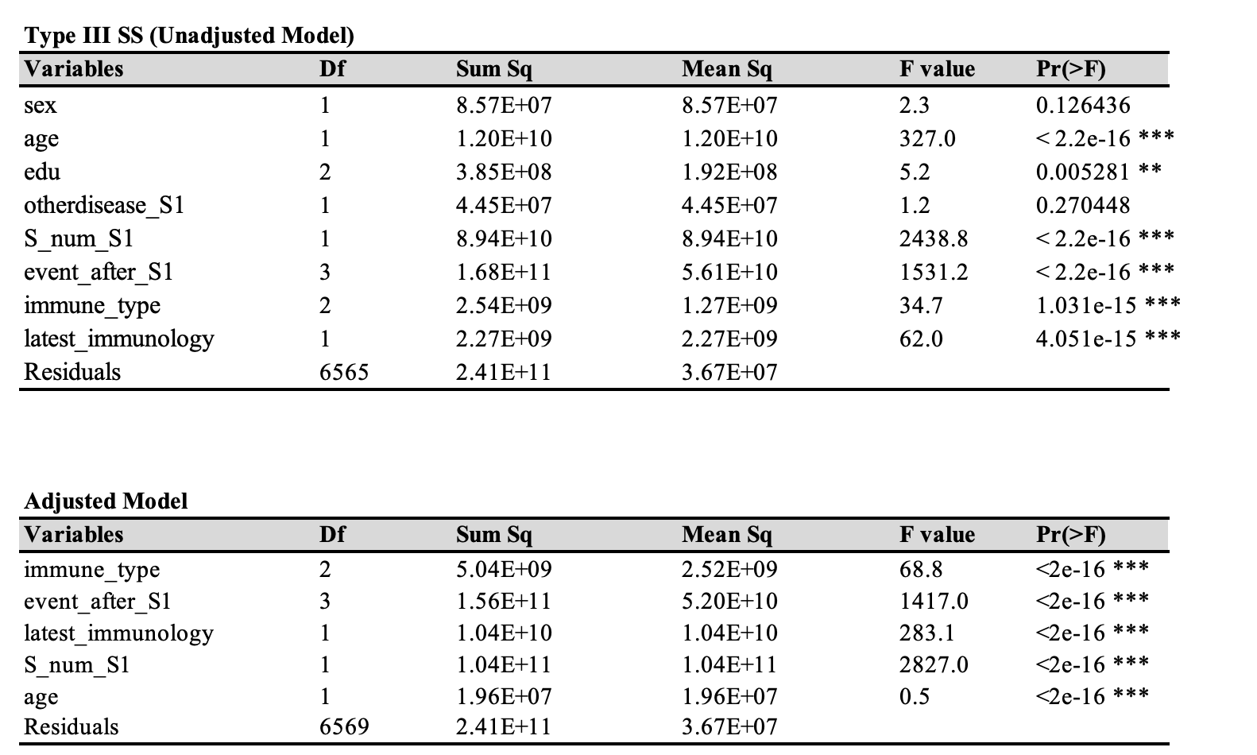
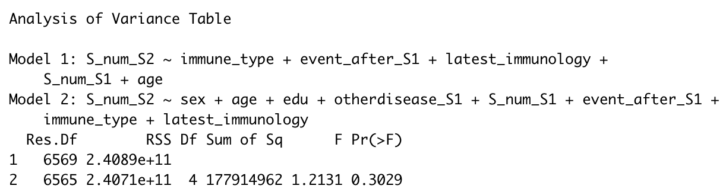
Cohort Study Model Selection

